Slide 1

Building Southern New Mexico’s Next Generation of Heavy Equipment Operators
How FAMCo put the 2026 New Mexico Economic Development Grant to work
Presented to the NMED Advisors | FAMCo, Inc. | Las Cruces, NM
Notes:
Welcome and thank you. In the next five minutes I will show how FAMCo put the grant to work: what we bought, who we trained, and where those people are today.

Slide 2



The Grant at a Glance
GRANT
2026 New Mexico Economic Development Grant
ADMINISTERED BY
Community Foundation of Southern NM
AWARDED
April 14, 2026
GRANT PERIOD
One year
Tenstar Heavy Equipment Simulator
Hands-on practice across all heavy equipment
Spent: $100,000
Mobile Command Center
A mobile command trailer built to carry the simulator to job sites
Spent: $105,000
Training Classroom Building
On-site at the FAMCo yard; houses the simulator
Spent: $35,000
Notes:
The grant was awarded April 14, 2026 through the Community Foundation of Southern New Mexico, with a one-year grant period. We invested in three things: a Tenstar simulator, a mobile command center to move it, and a classroom building to house it. [Add the dollar amount for each investment.]

Slide 3
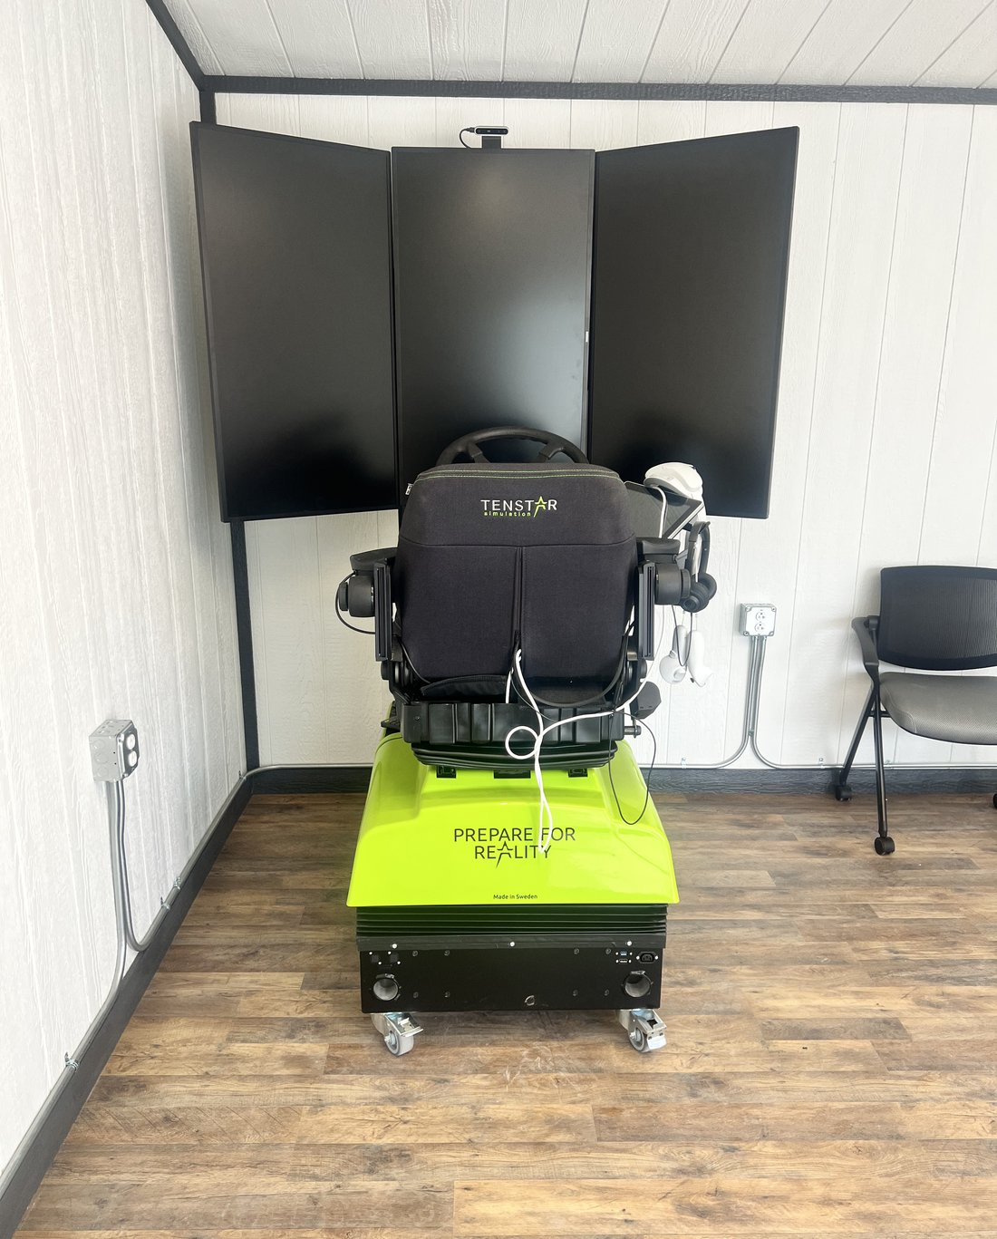
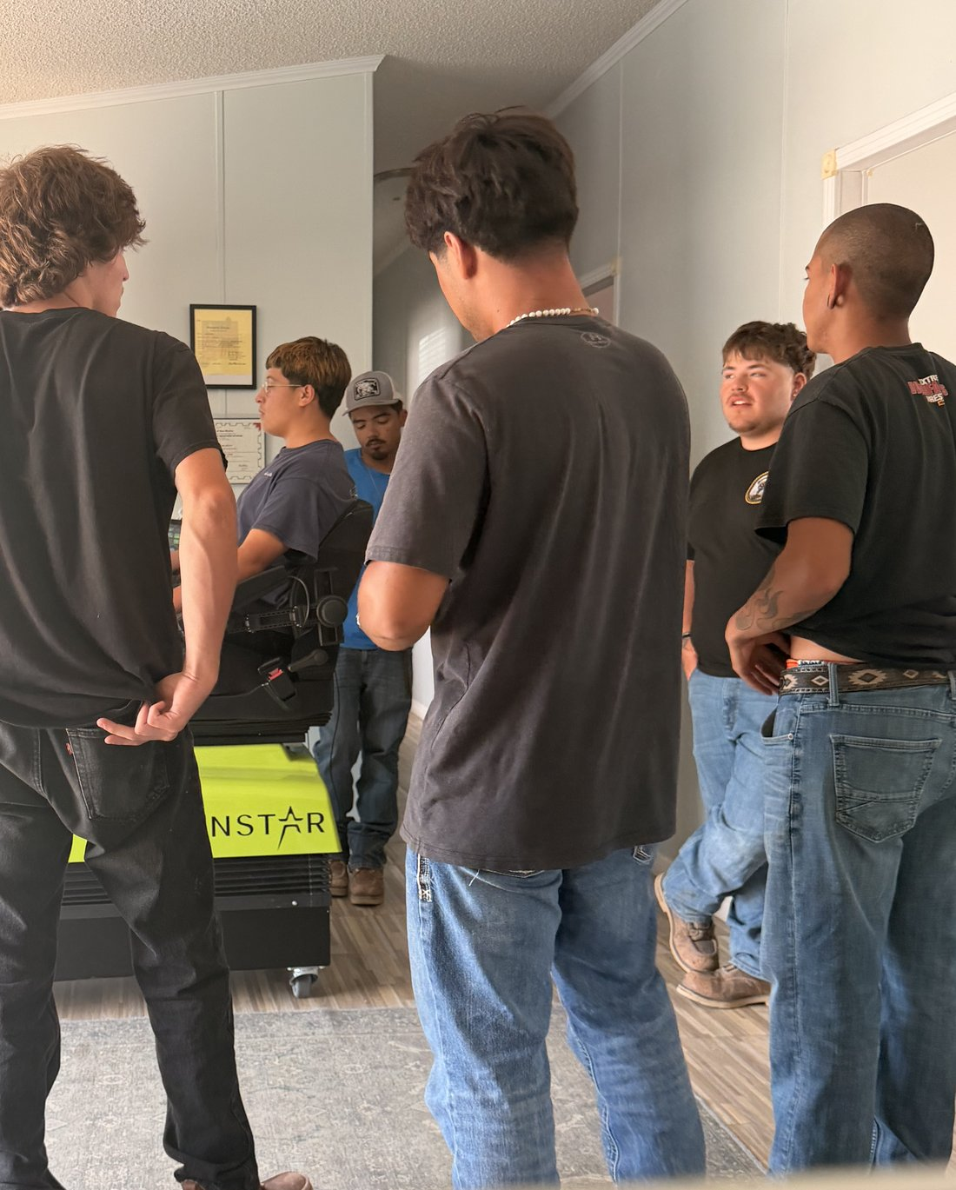
The Simulator in Action
Tenstar, trains on all heavy equipment
100+
hours logged by apprentices and pre-apprentices to date
Trainees build machine skills before working on live sites
Used by both the apprenticeship and the pre-apprenticeship
Tenstar simulator in the classroom
Pre-apprentices training on the simulator
Notes:
Our Tenstar simulator trains on all types of heavy equipment. Apprentices and pre-apprentices together have logged more than 100 hours on it so far. It gives trainees real machine time before they work on live job sites.

Slide 4
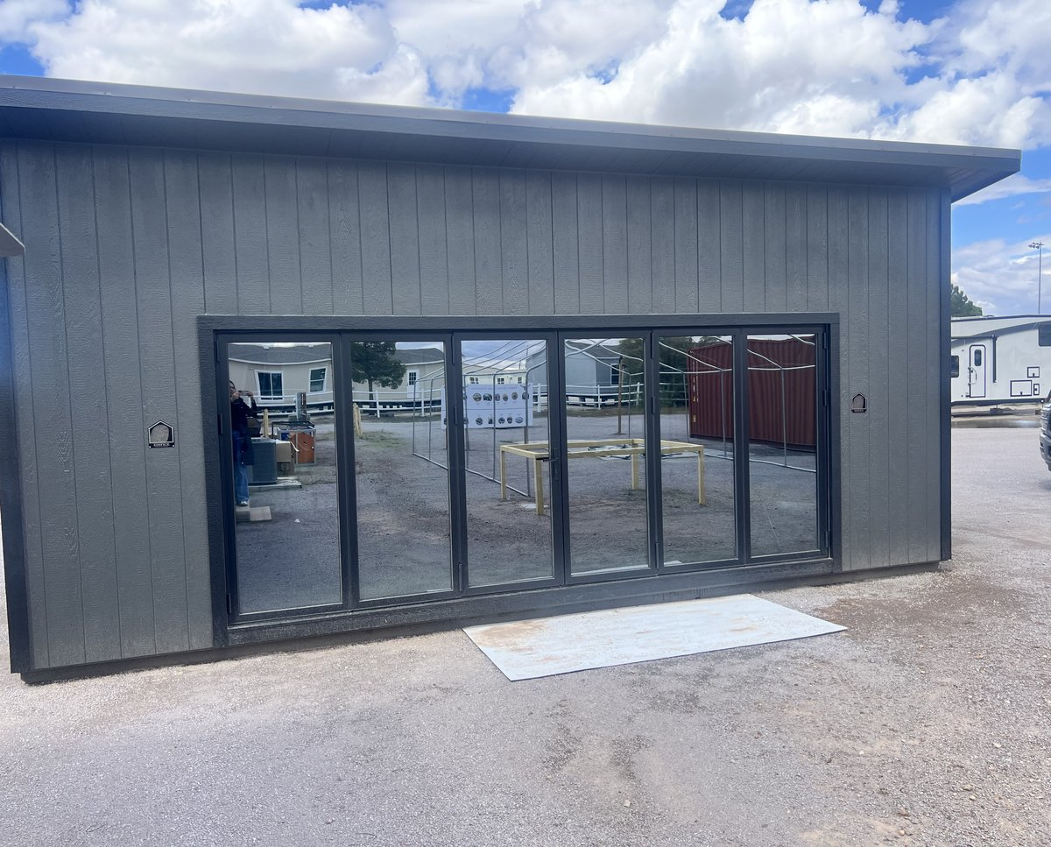
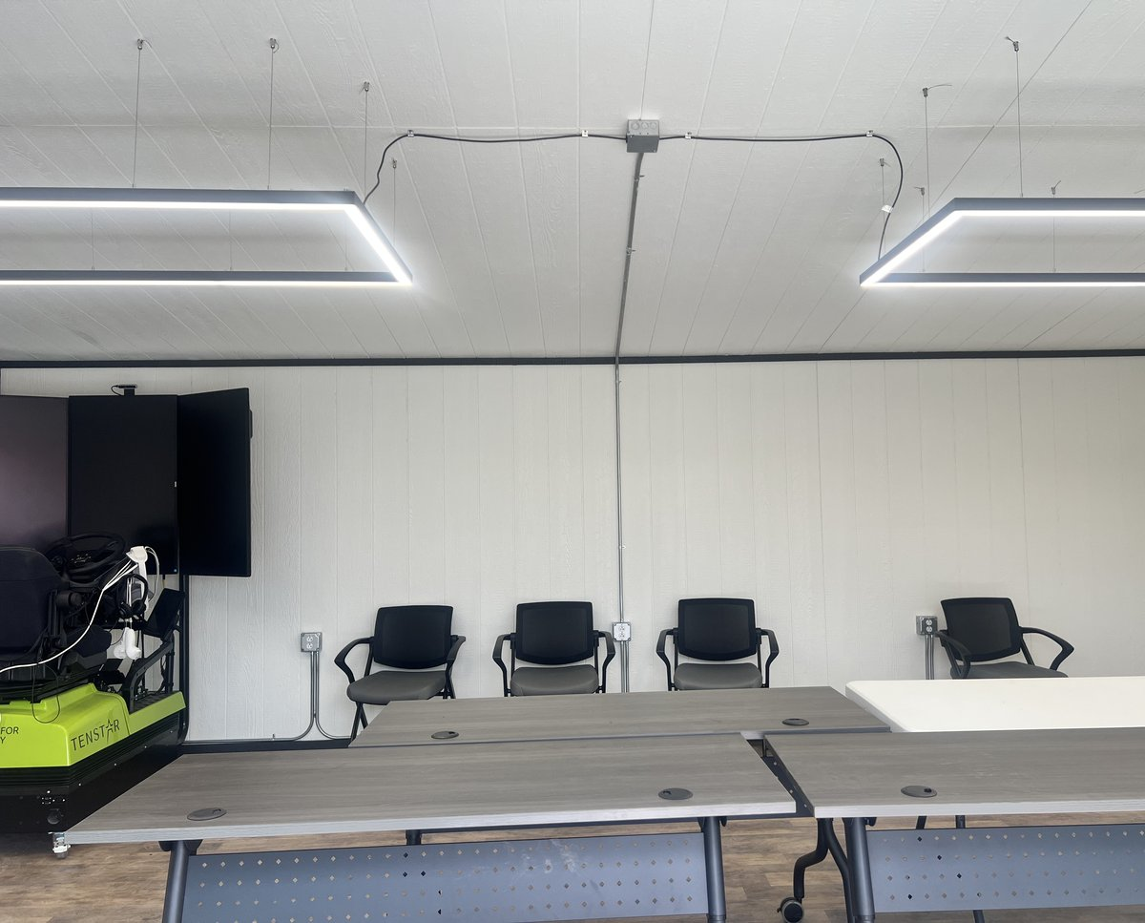
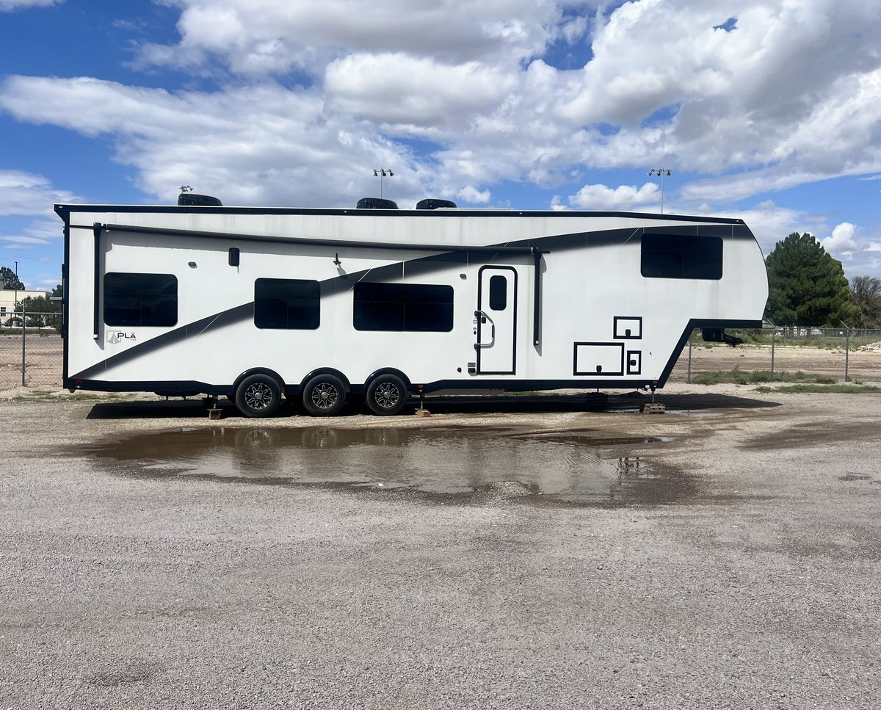
Classroom and Mobile Command Center
The Training Classroom
Inside The Classroom
Mobile Command Center
Purchased and set up at the FAMCo yard as a dedicated training space.
Houses the simulator, with room for instruction and group sessions.
A mobile command trailer designed to bring the simulator to job sites.
Notes:
We purchased a building at the FAMCo yard and turned it into a classroom that houses the simulator. The mobile command center is a toy hauler that lets us move the simulator to job sites, so training can happen where apprentices work.

Slide 5



Summer 2026 pre-apprenticeship pilot
7
In collaboration with the Bridge of Southern NM
A community partnership to reach and support new trainees
NCCER Core modules
Pre-apprentices completed the summer pilot
All 7 pre-apprentices finished the nationally recognized curriculum
Simulator time
Pre-apprentices trained on the Tenstar alongside our apprentices
Safety credentials
OSHA 10, First Aid, CPR and AED, earned by pre-apprentices and apprentices
Notes:
This summer we ran a pre-apprenticeship pilot with the Bridge of Southern New Mexico. Seven people completed it. They finished NCCER Core, trained on the simulator, and earned OSHA 10, First Aid, CPR and AED certifications, the same credentials our apprentices hold.

Slide 6
Results: training that leads to paychecks
7 of 7
4
$22/hr
pre-apprentices now employed or in an apprenticeship (100%)
Heavy Equipment Operator apprentices on the job
prevailing wage, 40-hour week, on job sites
Where the 7 pre-apprentices landed
2 FAMCo apprentices
3 FAMCo laborers
1 IEC electrical apprentice, RT Electric
1 Stack
Notes:
Of the seven pre-apprentices who completed the pilot, five were hired by FAMCo: two as apprentices and three as laborers. One more joined the IEC electrical apprenticeship and works for RT Electric. That is six of seven employed or in an apprenticeship. Two of our four Heavy Equipment Operator apprentices came out of the pilot, and all four earn prevailing wage, about $22 an hour for a 40-hour week, on job sites. We are helping local youth upskill and earn a wage at the same time.

Slide 7



What’s next
Take the simulator to job sites
Put the mobile command center to work for apprentices in the field
Grow our training footprint
FAMCo has broken ground on a training center in the industrial park
Keep the pipeline moving
Pre-apprentice to apprentice to a prevailing-wage career
Thank you. Questions?
Frankie Torres, Owner/President, FAMCo, Inc.
Notes:
Next we bring the simulator to job sites with the mobile command center, and FAMCo has broken ground on a training center in the industrial park. The goal is a steady pipeline from pre-apprenticeship to apprenticeship to a prevailing-wage career. Thank you, I am happy to take questions.

