Slide 1
Arrowhead Center at NMSU
Doña Ana Sprint Program Update
Kristin Morehead
Economic Development

Slide 2
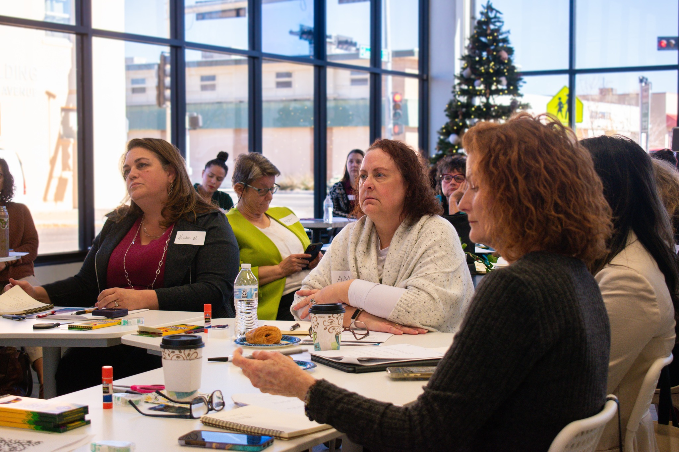




Doña Ana County Sprint Accelerators
WESprint Doña Ana: 6-week virtual Accelerator Program for women-owned businesses in Doña Ana County to test the feasibility of their business idea. September 2025.
BizSprint Doña Ana: 6-week virtual Accelerator Program for businesses in Doña Ana County to test the feasibility of their business ideas. February 2026.
StartupSprint: 6-week Accelerator Program for new businesses to test the feasibility of their business ideas and navigate initial startup processes. October 2025.
HealthSprint is an Accelerator Program for health-related businesses to test the feasibility of their business ideas. March 2026.
2

Slide 3
Doña Ana Sprints, 2025-26
40 participants
Range of businesses, services, retail, arts, technology, media
Business model canvas
Connections with local business experts, service providers, and Arrowhead advisors – 32 guest speakers
60 client mentoring meetings
Excellent feedback on program satisfaction and gaining new skills
Initial reporting: 112 jobs, $380,000 revenue (follow up in June for FY report)

Slide 4
Doña Ana Sprints Client Impacts
72% of participants identified as minority, women or another underrepresented demographic.
75% reported they made a pivot to their business plan as a result of the program.
85% reported they took direct actions toward moving their business forward as a result of the program (e.g. formed an LLC, integrated AI and automations, new business plan)
100% reported they discovered new business resources as a result of the program.
71% reported growing their professional network as a result of the program.
71% reported the program made a positive impact on their business operations.
66% report the program made a positive impact on their professional effectiveness.
80% reported the program exceeded their expectations with the rest noting the program met expectations.

Slide 5



Doña Ana Sprints Brand Visibility

Slide 6
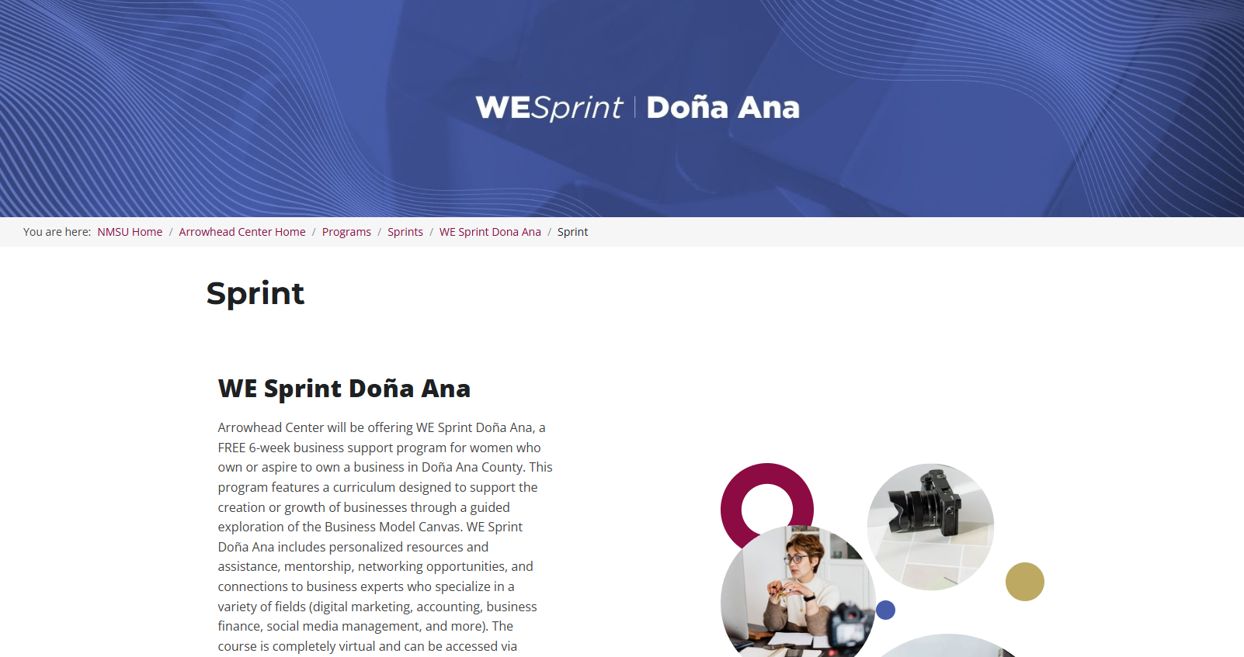
Doña Ana Sprints Brand Visibility

Slide 7
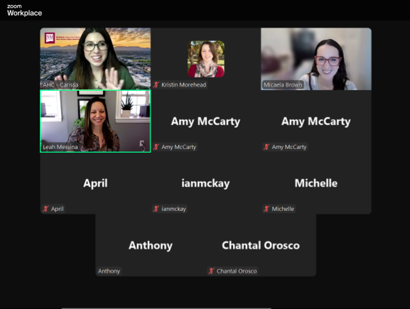
BizSprint Doña Ana

Slide 8
Doña Ana Sprint Testimonials
The Arrowhead Accelerator Program BizSprint helped guide me through structuring my own business for my own product even though I have an MBA. It helped me think like a founder, not a consultant. Invaluable!
Arrowhead’s Startup Sprint DAC gave us the tools and clarity to turn La Fuerza from a dream into a viable social-enterprise program that will create real opportunities for domestic violence survivors. It was one of the most valuable accelerators I’ve ever participated in. We look forward to a long-term relationship.
Arrowhead is an amazing resource for business owners, especially for startups! Being an entrepreneur often feels like you are on your own, so having access to consulting and seasoned experts who can help guide you is an invaluable resource for anyone with a business.
Consulting is somewhat more ethereal than a business that sells tangible products. While many of the tenets with respect to planning, financing and marketing apply, it probably requires a deeper dive to strategize the marketing and customer development piece. Several of the speakers and topics covered really resulted in my taking a hard look at the approach that will be necessary to generate revenue and provide quality services.

Slide 9
Thank You
For more information, contact:
Kristin Morehead, Ph.D.
Interim Deputy Director
NMSU Arrowhead Center
505-433-1827
kmorehea@nmsu.edu
http://arrowheadcenter.nmsu.edu/

