Slide 1


NM ECONOMIC DEVELOPMENT GRANT
2025 Grant Closeout Draft
Presented April 2025

Slide 2
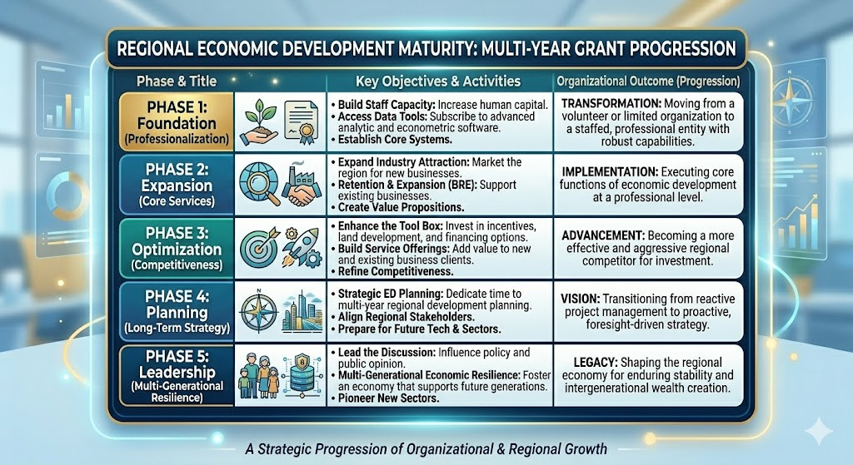
NMEDF GRANT TRAJECTORY

Slide 3
ABOUT MVEDA
Multi-Year Grant Goal:
“Build Momentum, Grow Services, Compete, Lead”
2025 ACTIVITIES | LONG-TERM GOAL
FDI Advancement & Attraction | Global Brand Recognition
Skill Set Readiness | Sustainable Talent Pipeline
Strategic Planning Initiatives | Pro-active Efforts to Grow Competitiveness
Shaping Conversations for Growth | Multi-Generational Economic Resilience

Slide 4
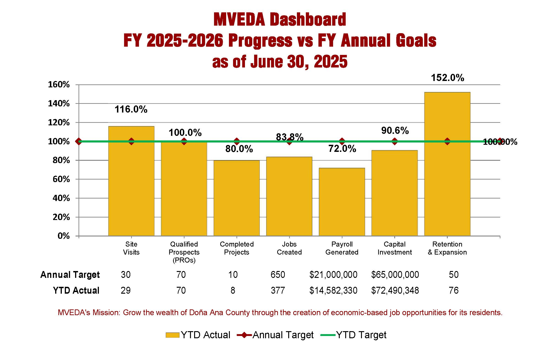
RESULTS
2024-’25 Full Fiscal Year
INDUSTRY ATTRACTION
Asset-based & targeted industry marketing approach focused on value additive to industry.

Slide 5
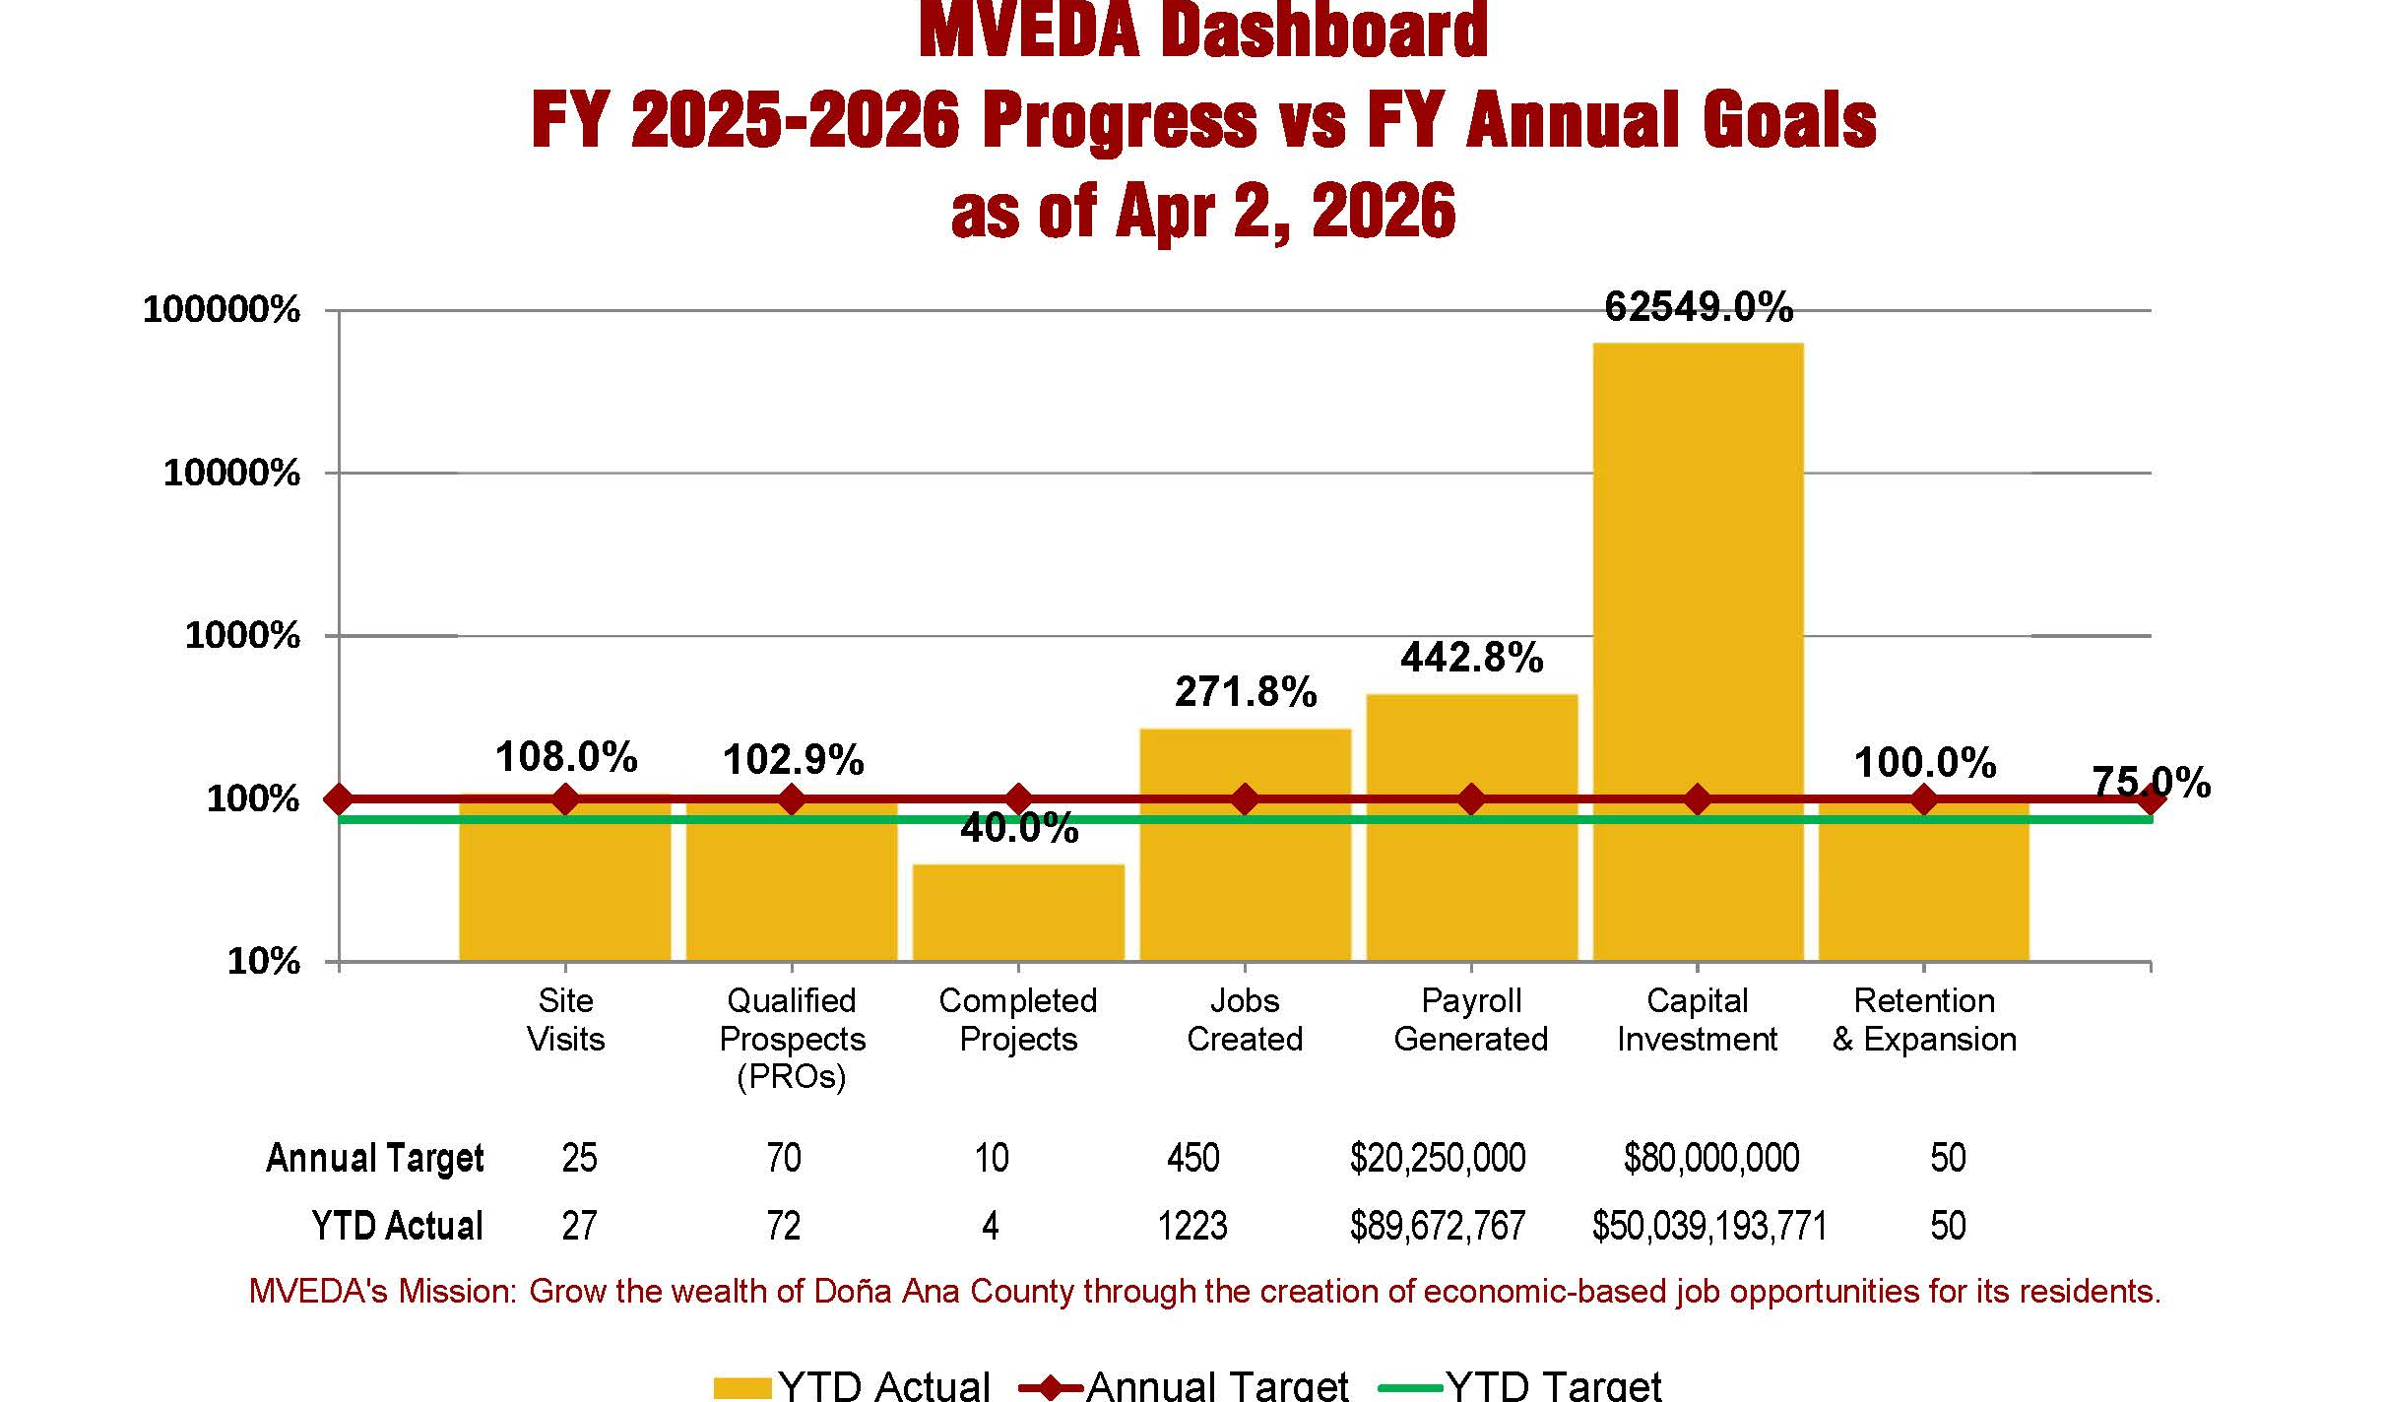
RESULTS
2025-’26 Through 3 Quarters
INDUSTRY ATTRACTION
Asset-based & targeted industry marketing approach focused on value additive to industry.

Slide 6
RESULTS
5 Year Comparisons-Year End
INDUSTRY ATTRACTION
Asset-based & targeted industry marketing approach focused on value additive to industry.

Slide 7


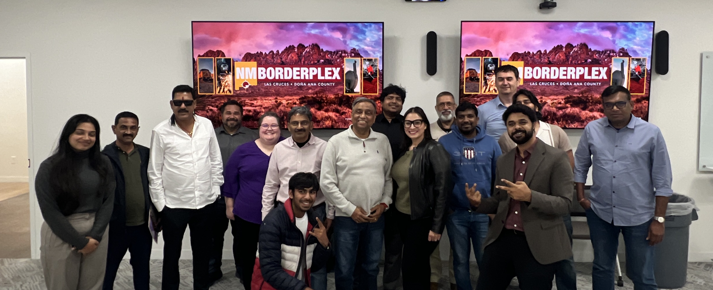
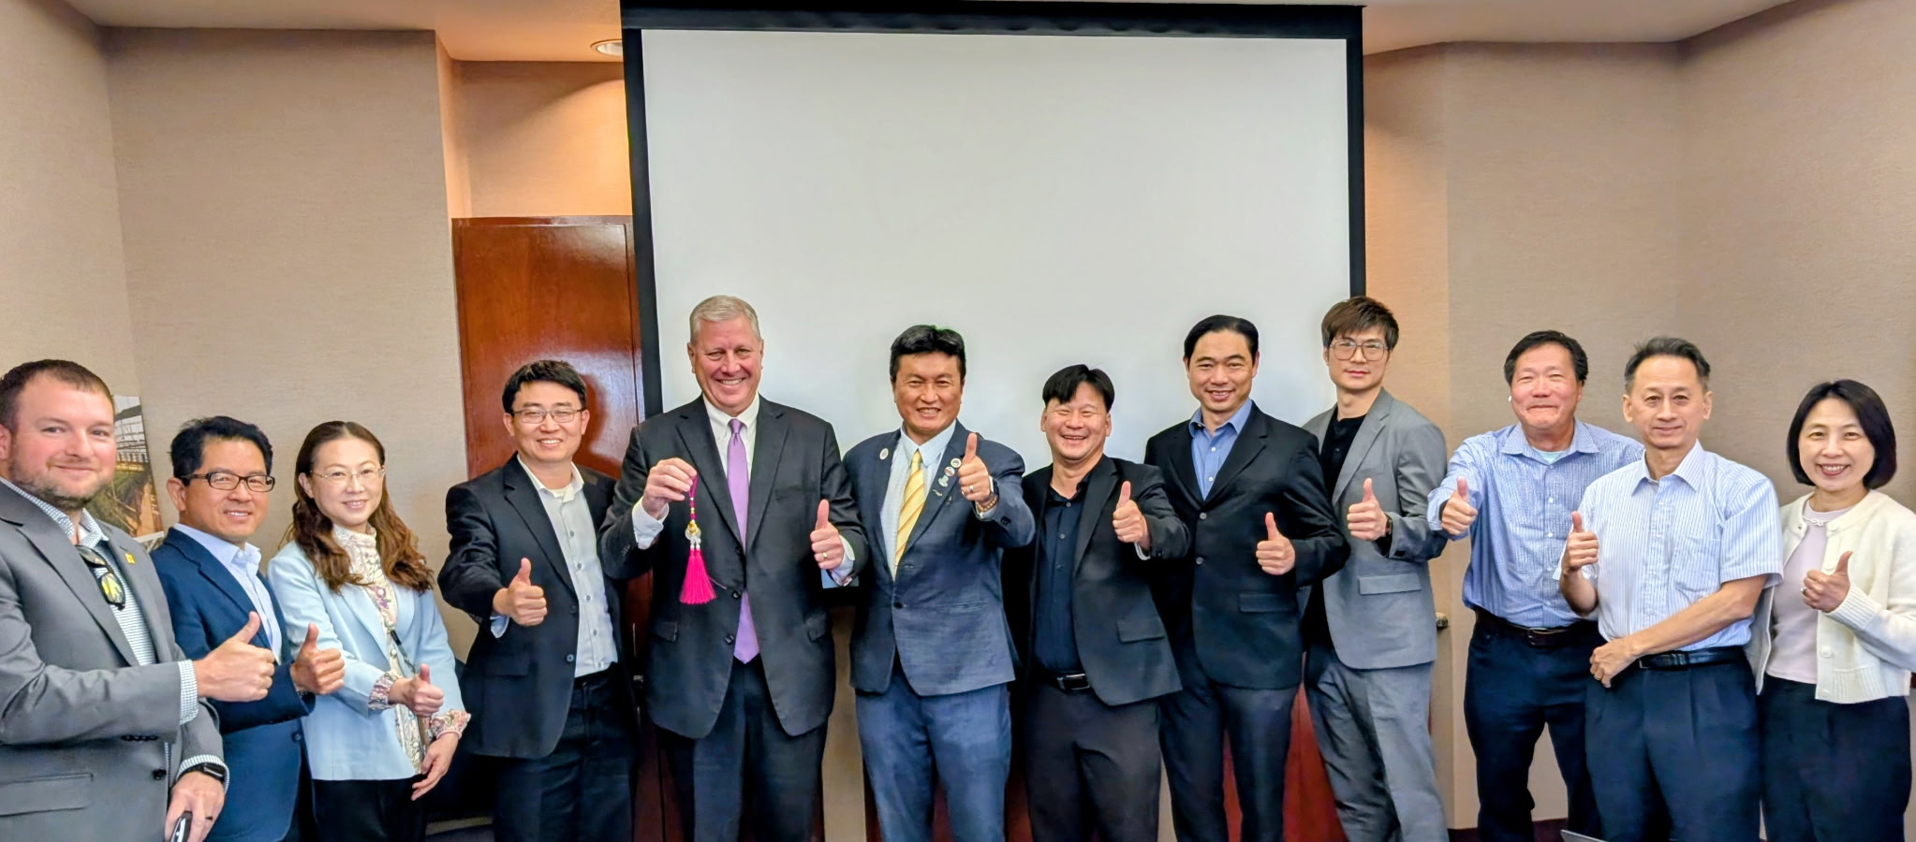


Activity #1: FDI Positioning & Attraction
Center of Trade for North America
Five (5) Indian Delegations
Two (2) Taiwanese Delegations
NMTradeport Planning, Funding, Promotion
Canadian Industry Outreach Campaign
FDI CAMPAIGNS

Slide 8

Activity #2: Skill Set Readiness
Automate-UP
2024 Governor’s Conference Award
Leveraged Funding - $100k towards Certifications
Expanded Certifications (beyond advanced manufacturing)
Food Processing Standards,
Software Development,
Telehealth,
Robotics,
Construction Trades.
Workforce Collaborations/Partnerships
Core Partners: NMSU, DACC, Independent Schools
New/Expanded:
Bridge of Southern New Mexico
Workforce Collaborative & Resiliency
Southern NM Independent Electrical Contractors
AI Certification
Partnership with AI Institute/NMSU Global
Small Business AI Starter Course
Awareness Campaign/Seminars
(82% of Small Businesses Feel AI is not Applicable)
SKILLS DEVELOPMENT

Slide 9
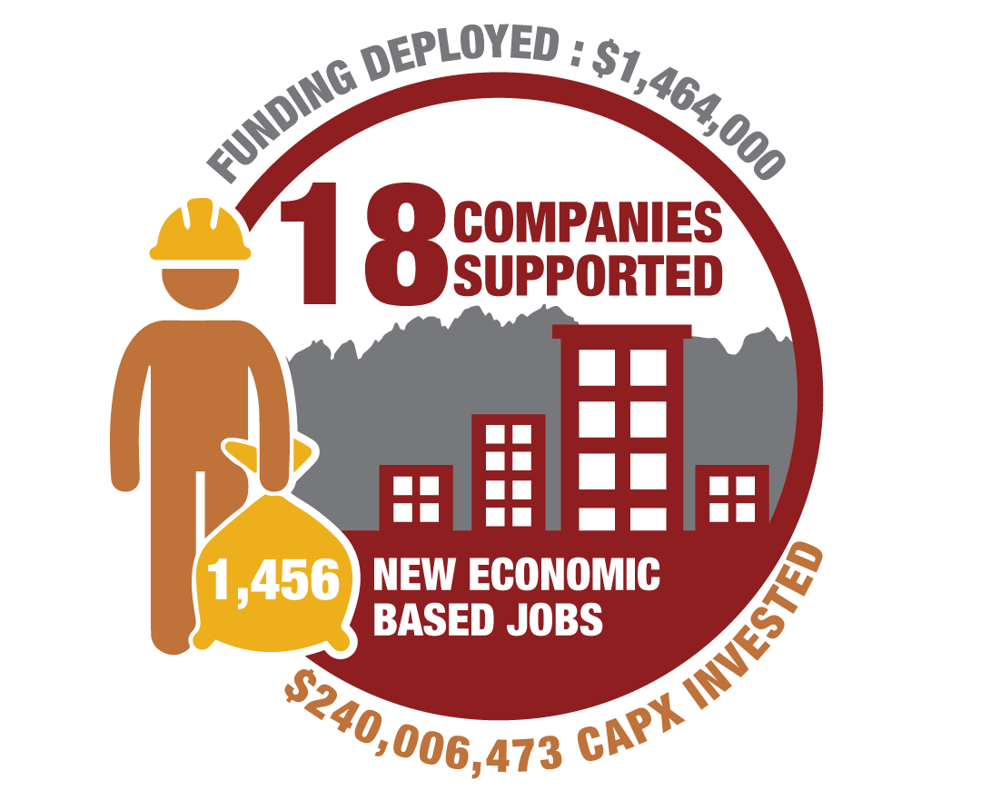
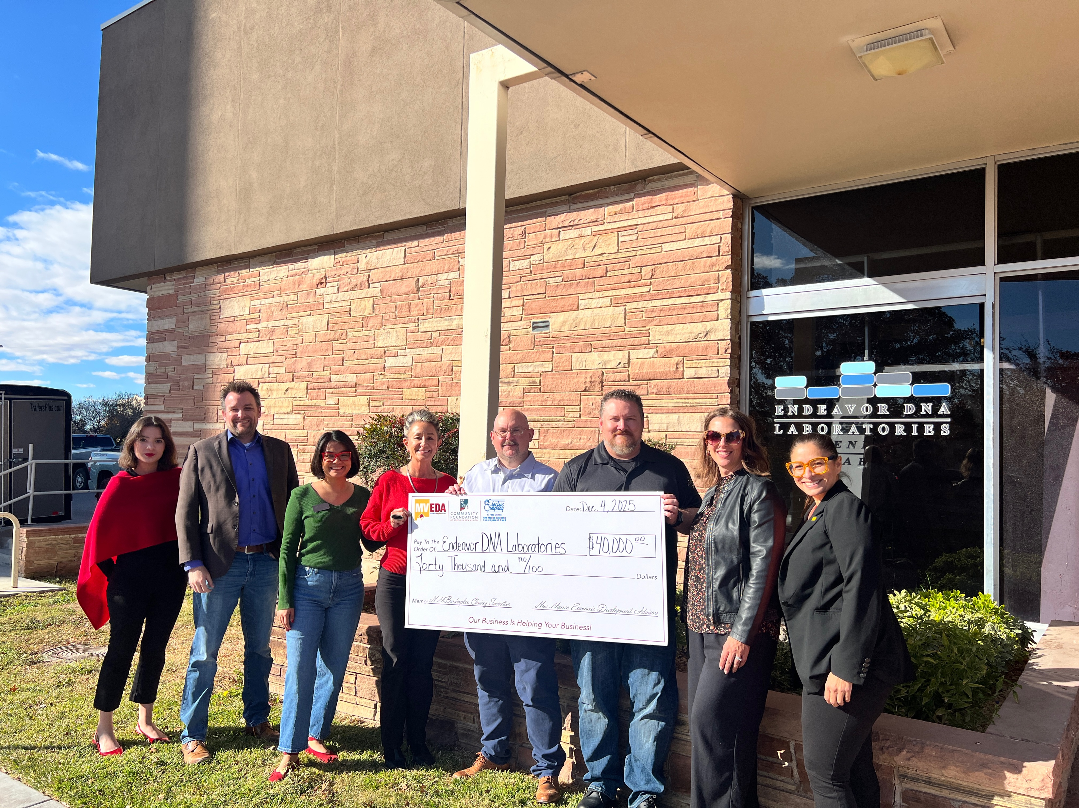
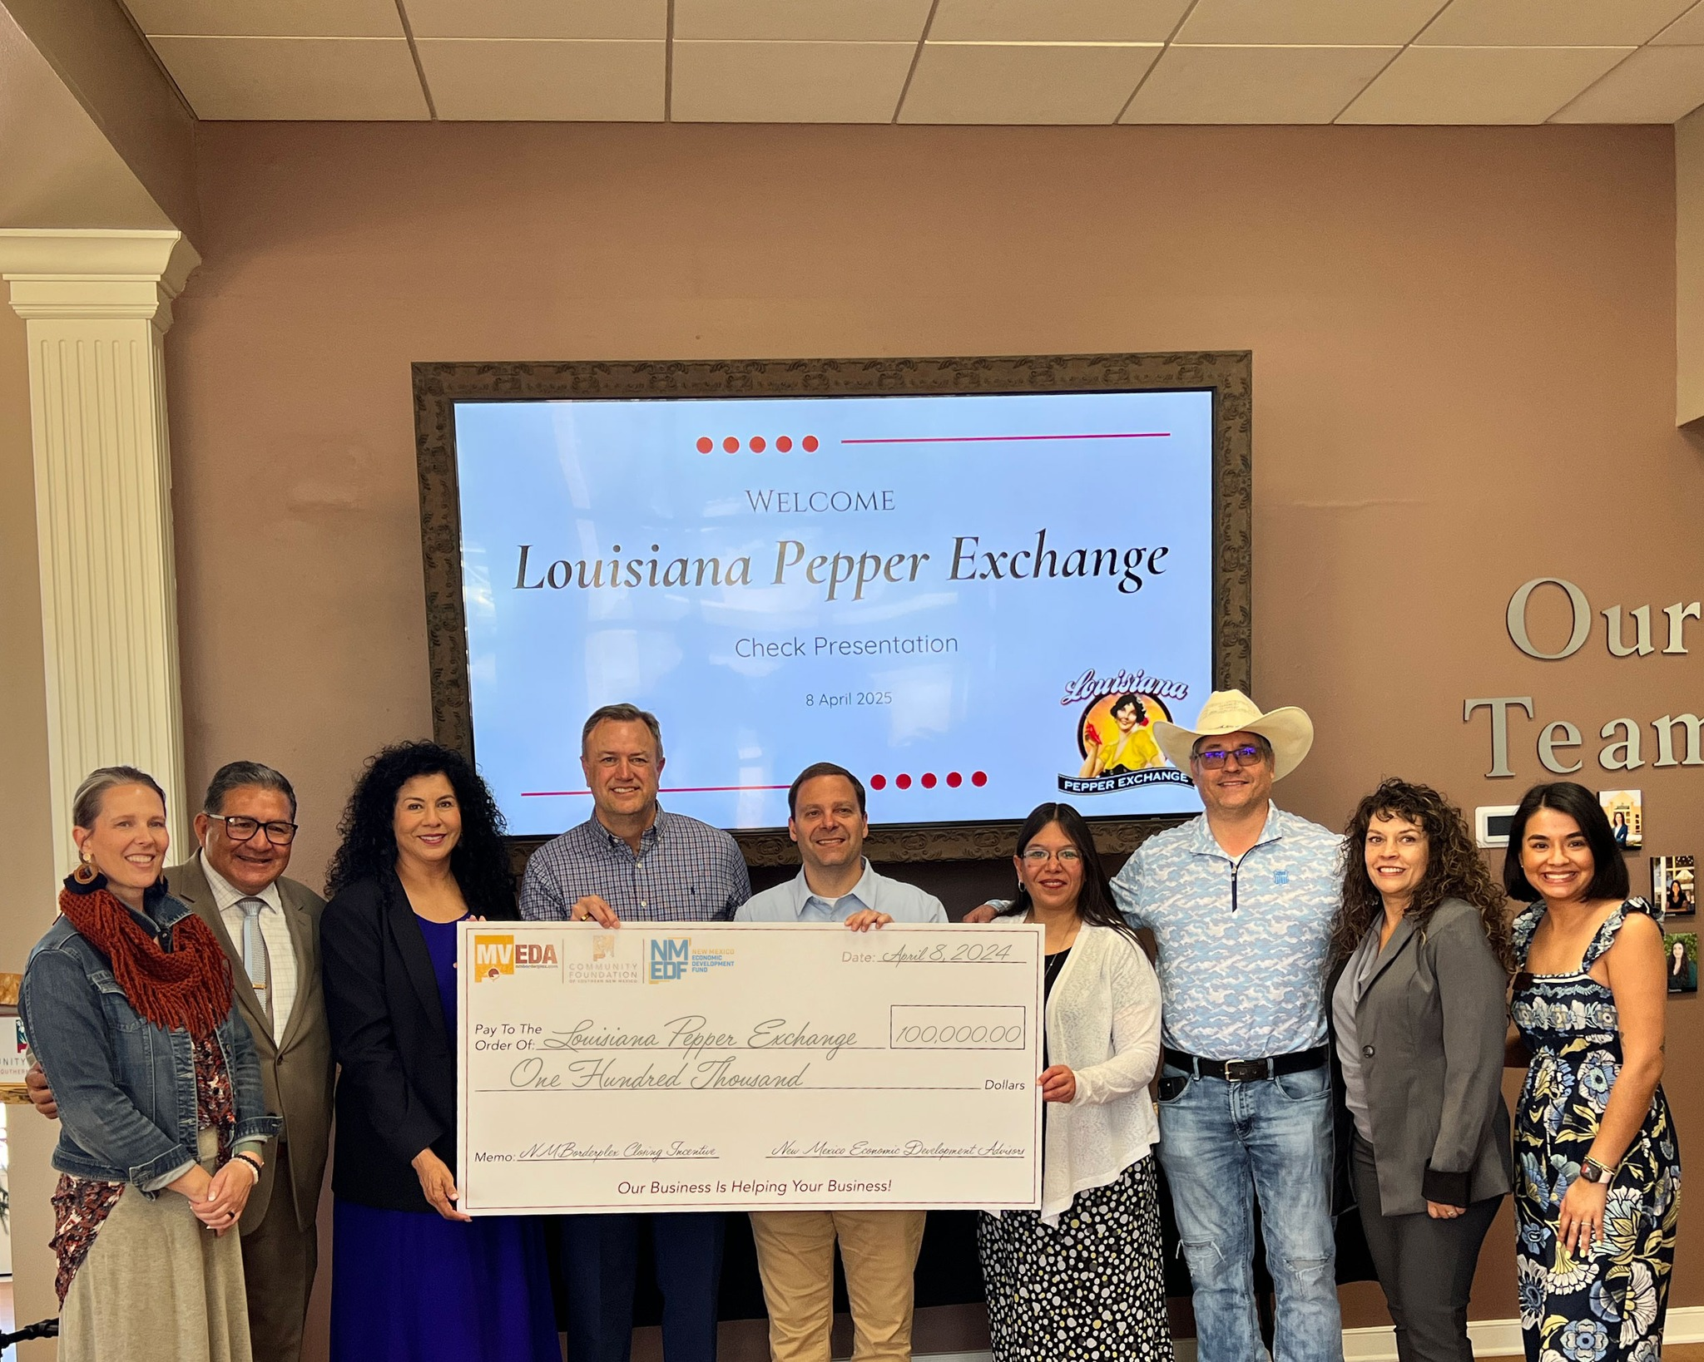
Activity #3: Strategic Planning & Competitivenss
NMBorderplex Closing Incentive
$678,000 | 2021 Funding Allocation
$500,000 | 2022 Funding Allocation
$500,000 | 2023 Funding Allocation
$1,678,000 | Total Funding
Total Funds Committed
$275,000 | 2021
$241,000 | 2022
$310,000 | 2023
$50,000 | 2024
$188,000 | 2025
$400,000 | 2026
$1,464,000 | Total Committed
Key Highlights
$214,000 Remaining
Post Performance Award
ROI Impact Objectives
Supports Large & Small Projects
Kept Us in the Game

Slide 10
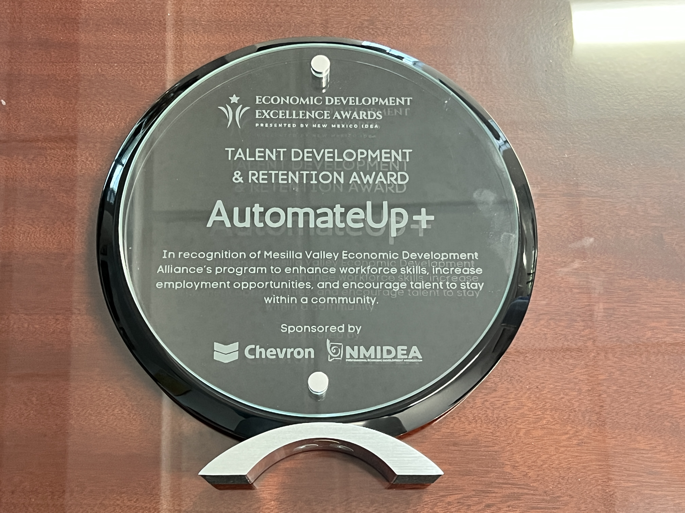

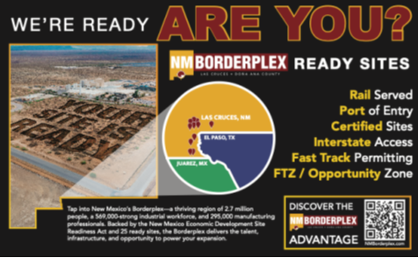
Activity #3: Strategic Planning & Competitiveness
Pre-Spec Development Program
Partnership w/City of Las Cruces
Reduces Developer Risk-Expedites Time to Market Facilities
In Discussions with 3 Out of State Developers
2025 Governor’s Conference Awardee
Expect Spec. Development Begin 1st Half FY 26-’27
STRATEGIC INITIATIVES
Site Readiness
Advocacy for Legislative Funding
2025 HB19/SB169 - $94m
Growing Industrial Ready Sites
LC, ST, Vado/Berino & Chaparral
Marketing in addition to resources.

Slide 11
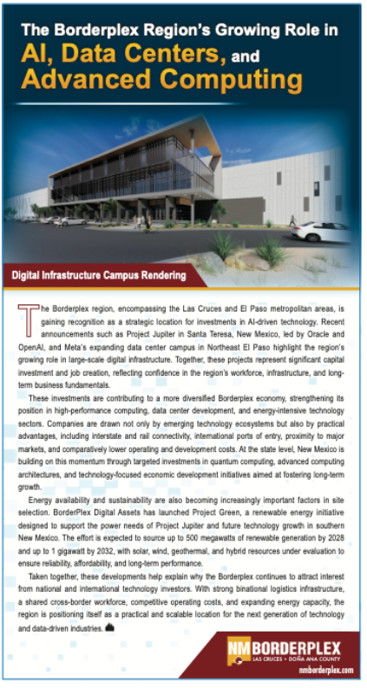


Activity #4: Shaping the Economy
BORDERPLEX OPPORTUNITY
“Advanced Manufacturing Hub of North America.”
Chihuahua shifting from low-cost assembly manufacturing to high value advanced manufacturing.
Chihuahua now leads Mexico in high value exports.
Led by computer electronics sector, driven by integrated data center supply chains.
Supply chains growing in El Paso & Dona Ana County.
Jupiter/Meta are only a part of the opportunity.
GOING FORWARD
Driving conversations on long-term economic trends & resilience
Shaping long term economic strategies
Influencing policy, investment, and regional direction
MVEDA/Borderplex Alliance Partnership has never been as critical
TRANSFORMATIONAL LEADERSHIP

Slide 12
Thank you!
NMEDF & Advisory Committee
Q&A

