Slide 1

WELCOME

Slide 2






ECONOMIC DEVELOPMENT
2025 METRICS
6
$1.79B
COMPLETED PROJECTS
TOTAL INVESTMENT
$336.9M
4,239
IN PAYROLL
NEW JOBS
98
90
DATA REQUESTS
RFPS
Notes:
Wiwynn- Socorro; Vinton- Vinton, TX; Meta- 3.5 miles from Chaparal, NM; Thyssenkrupp- Santa Teresa; SE 10% NM

Slide 3







JOINT OUTBOUND MARKETING
February 2025
September 2025
April 2025
March 2025
October 2025
April 2025
April 2025
Notes:
MD&M- CD with MVEDA; Site Selectors G- Marcos promoted SNM; Space- Shared marketing mats with SPA& NL promoted SNM; Data Ctr World- MD promoted SNM (Vado); SEDC- MD promoted SNM; Consultants forum- MD promoted SNM; Semicon West joint effort with MVEDA to recruit companies (used shared targeted list; shared same one-pager)

Slide 4



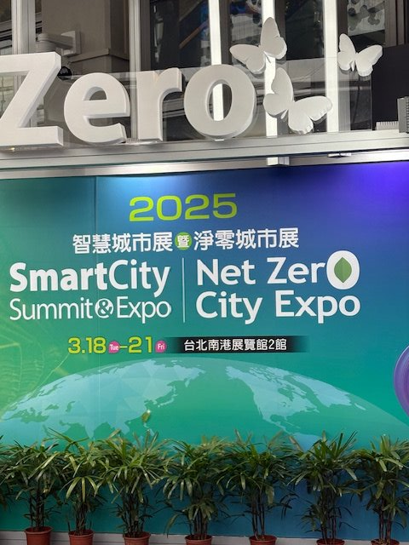
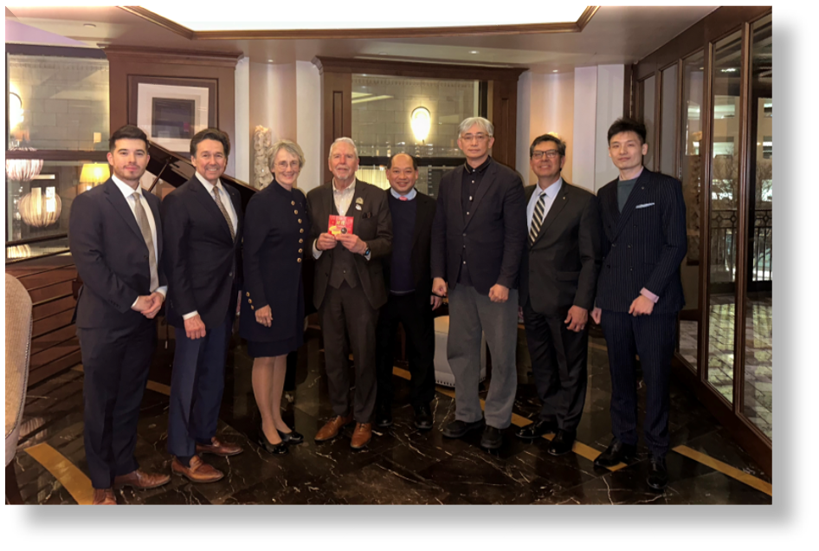

INBOUND MARKETING
Site Visit
Readiness Assessment
TEEMA/TECO
Taipei Smart City Summit
Notes:
TEEMA- Santa Teresa; inventec/servers- Santa Teresa site visit Iron Horse Industrial Park; GLS- Vado, Chaparral, and land named “stateland” behind Organ Mtn HS; MD and JB promoted SNM

Slide 5
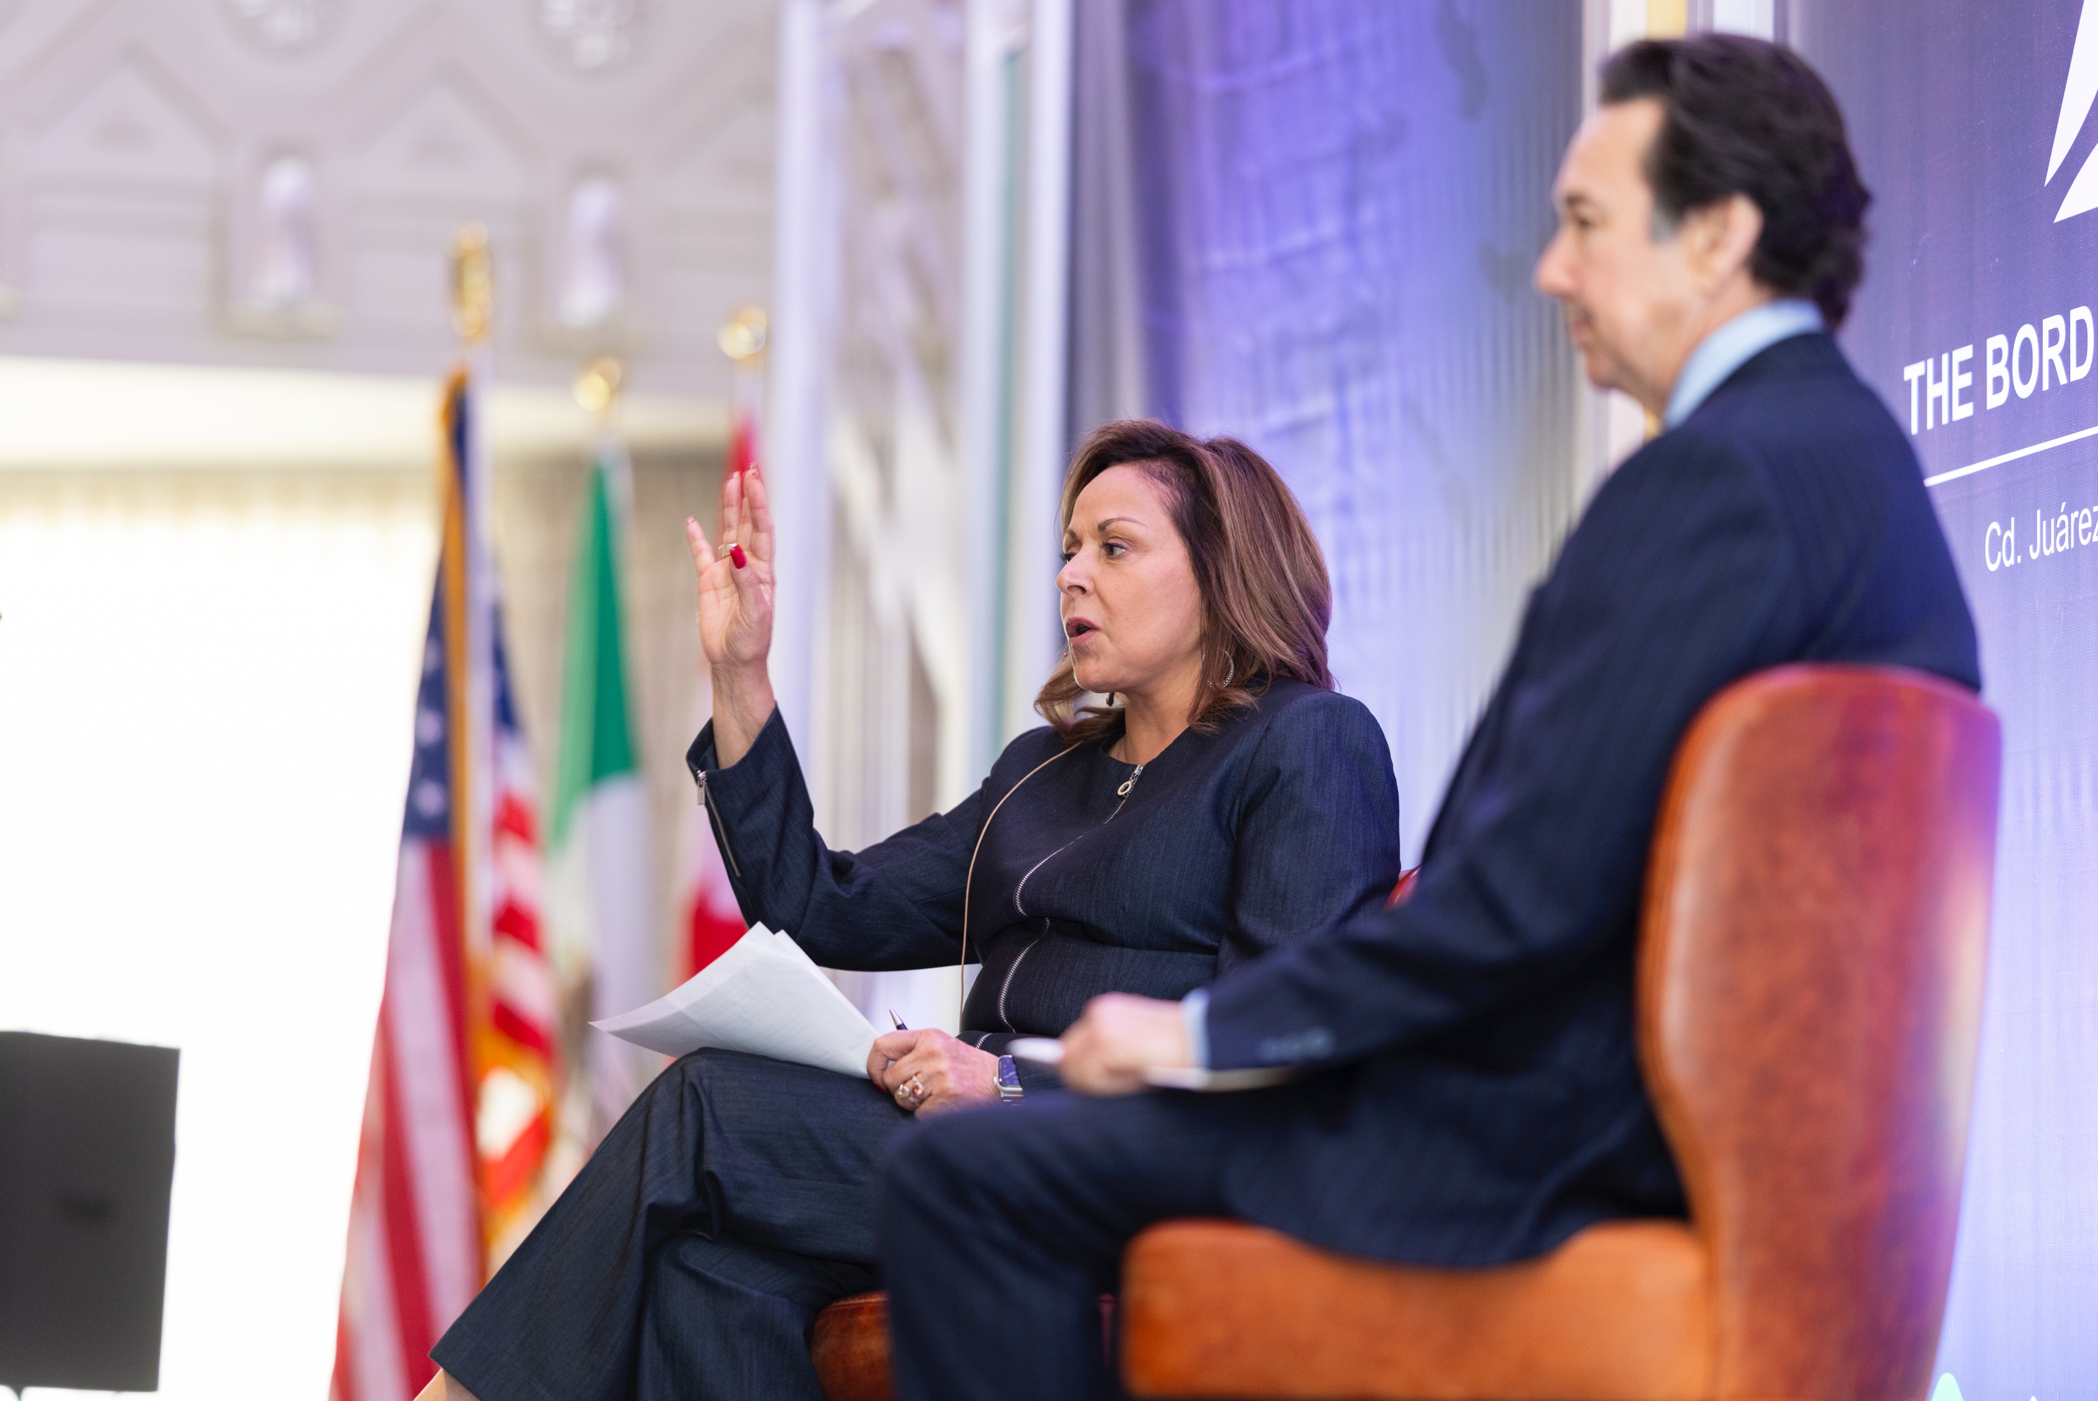
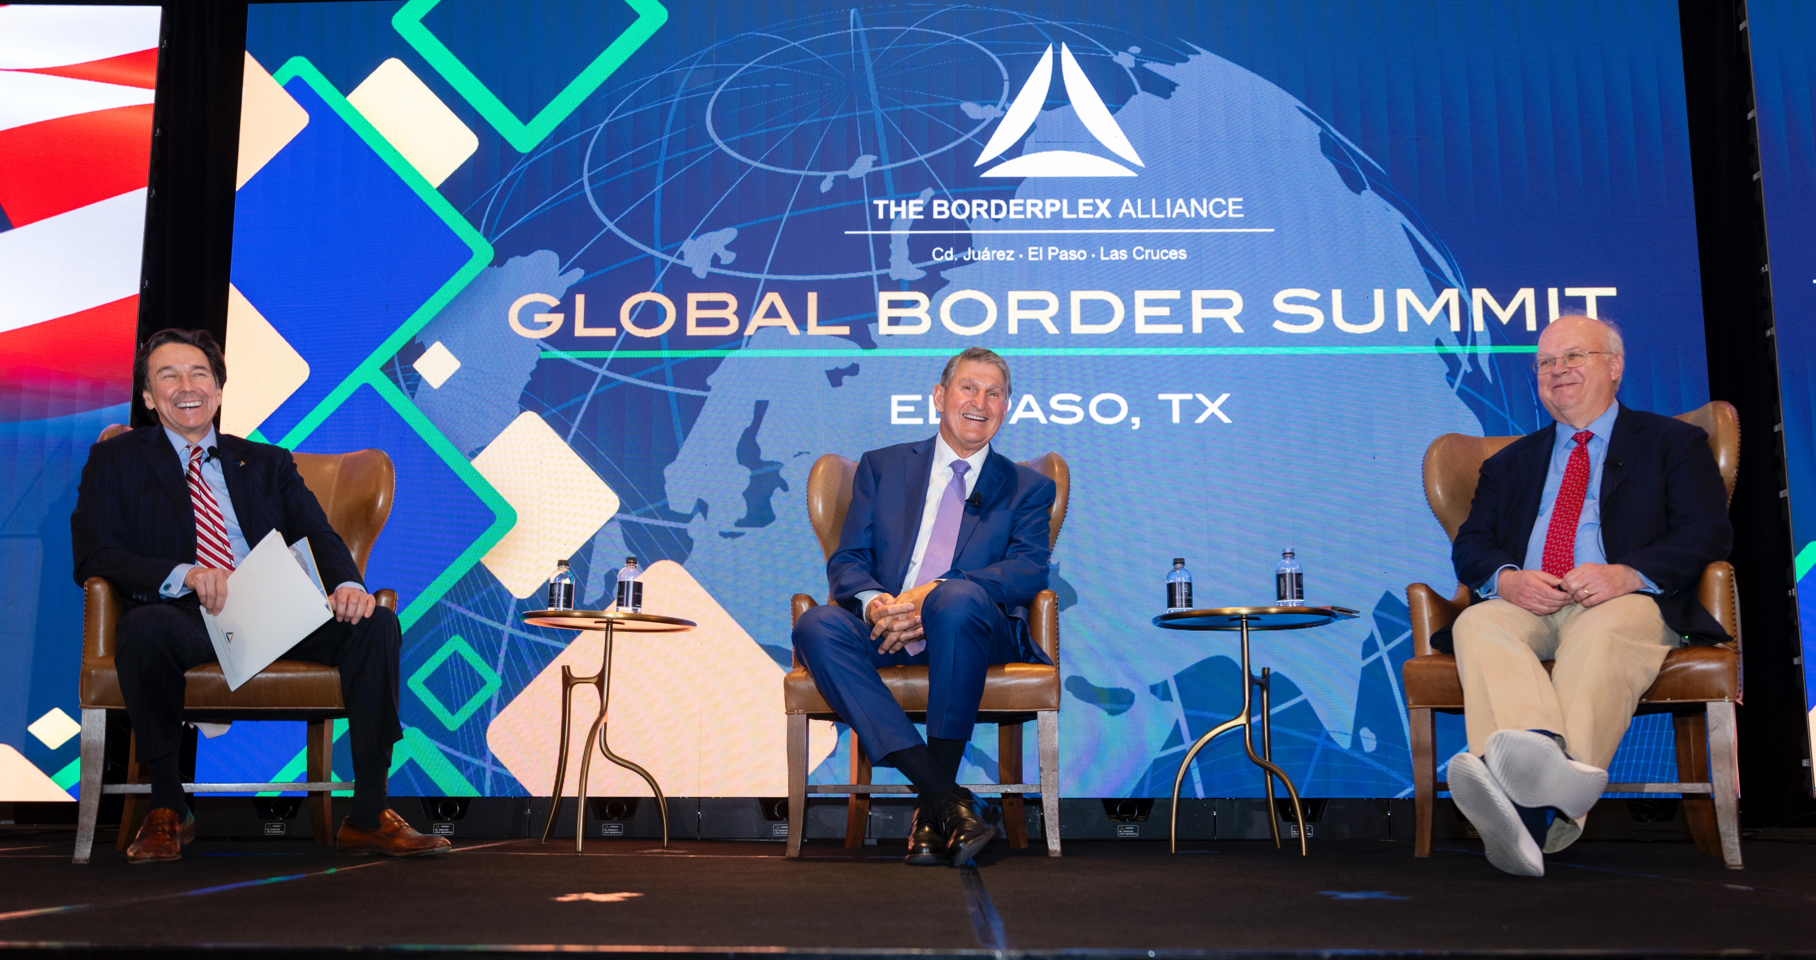
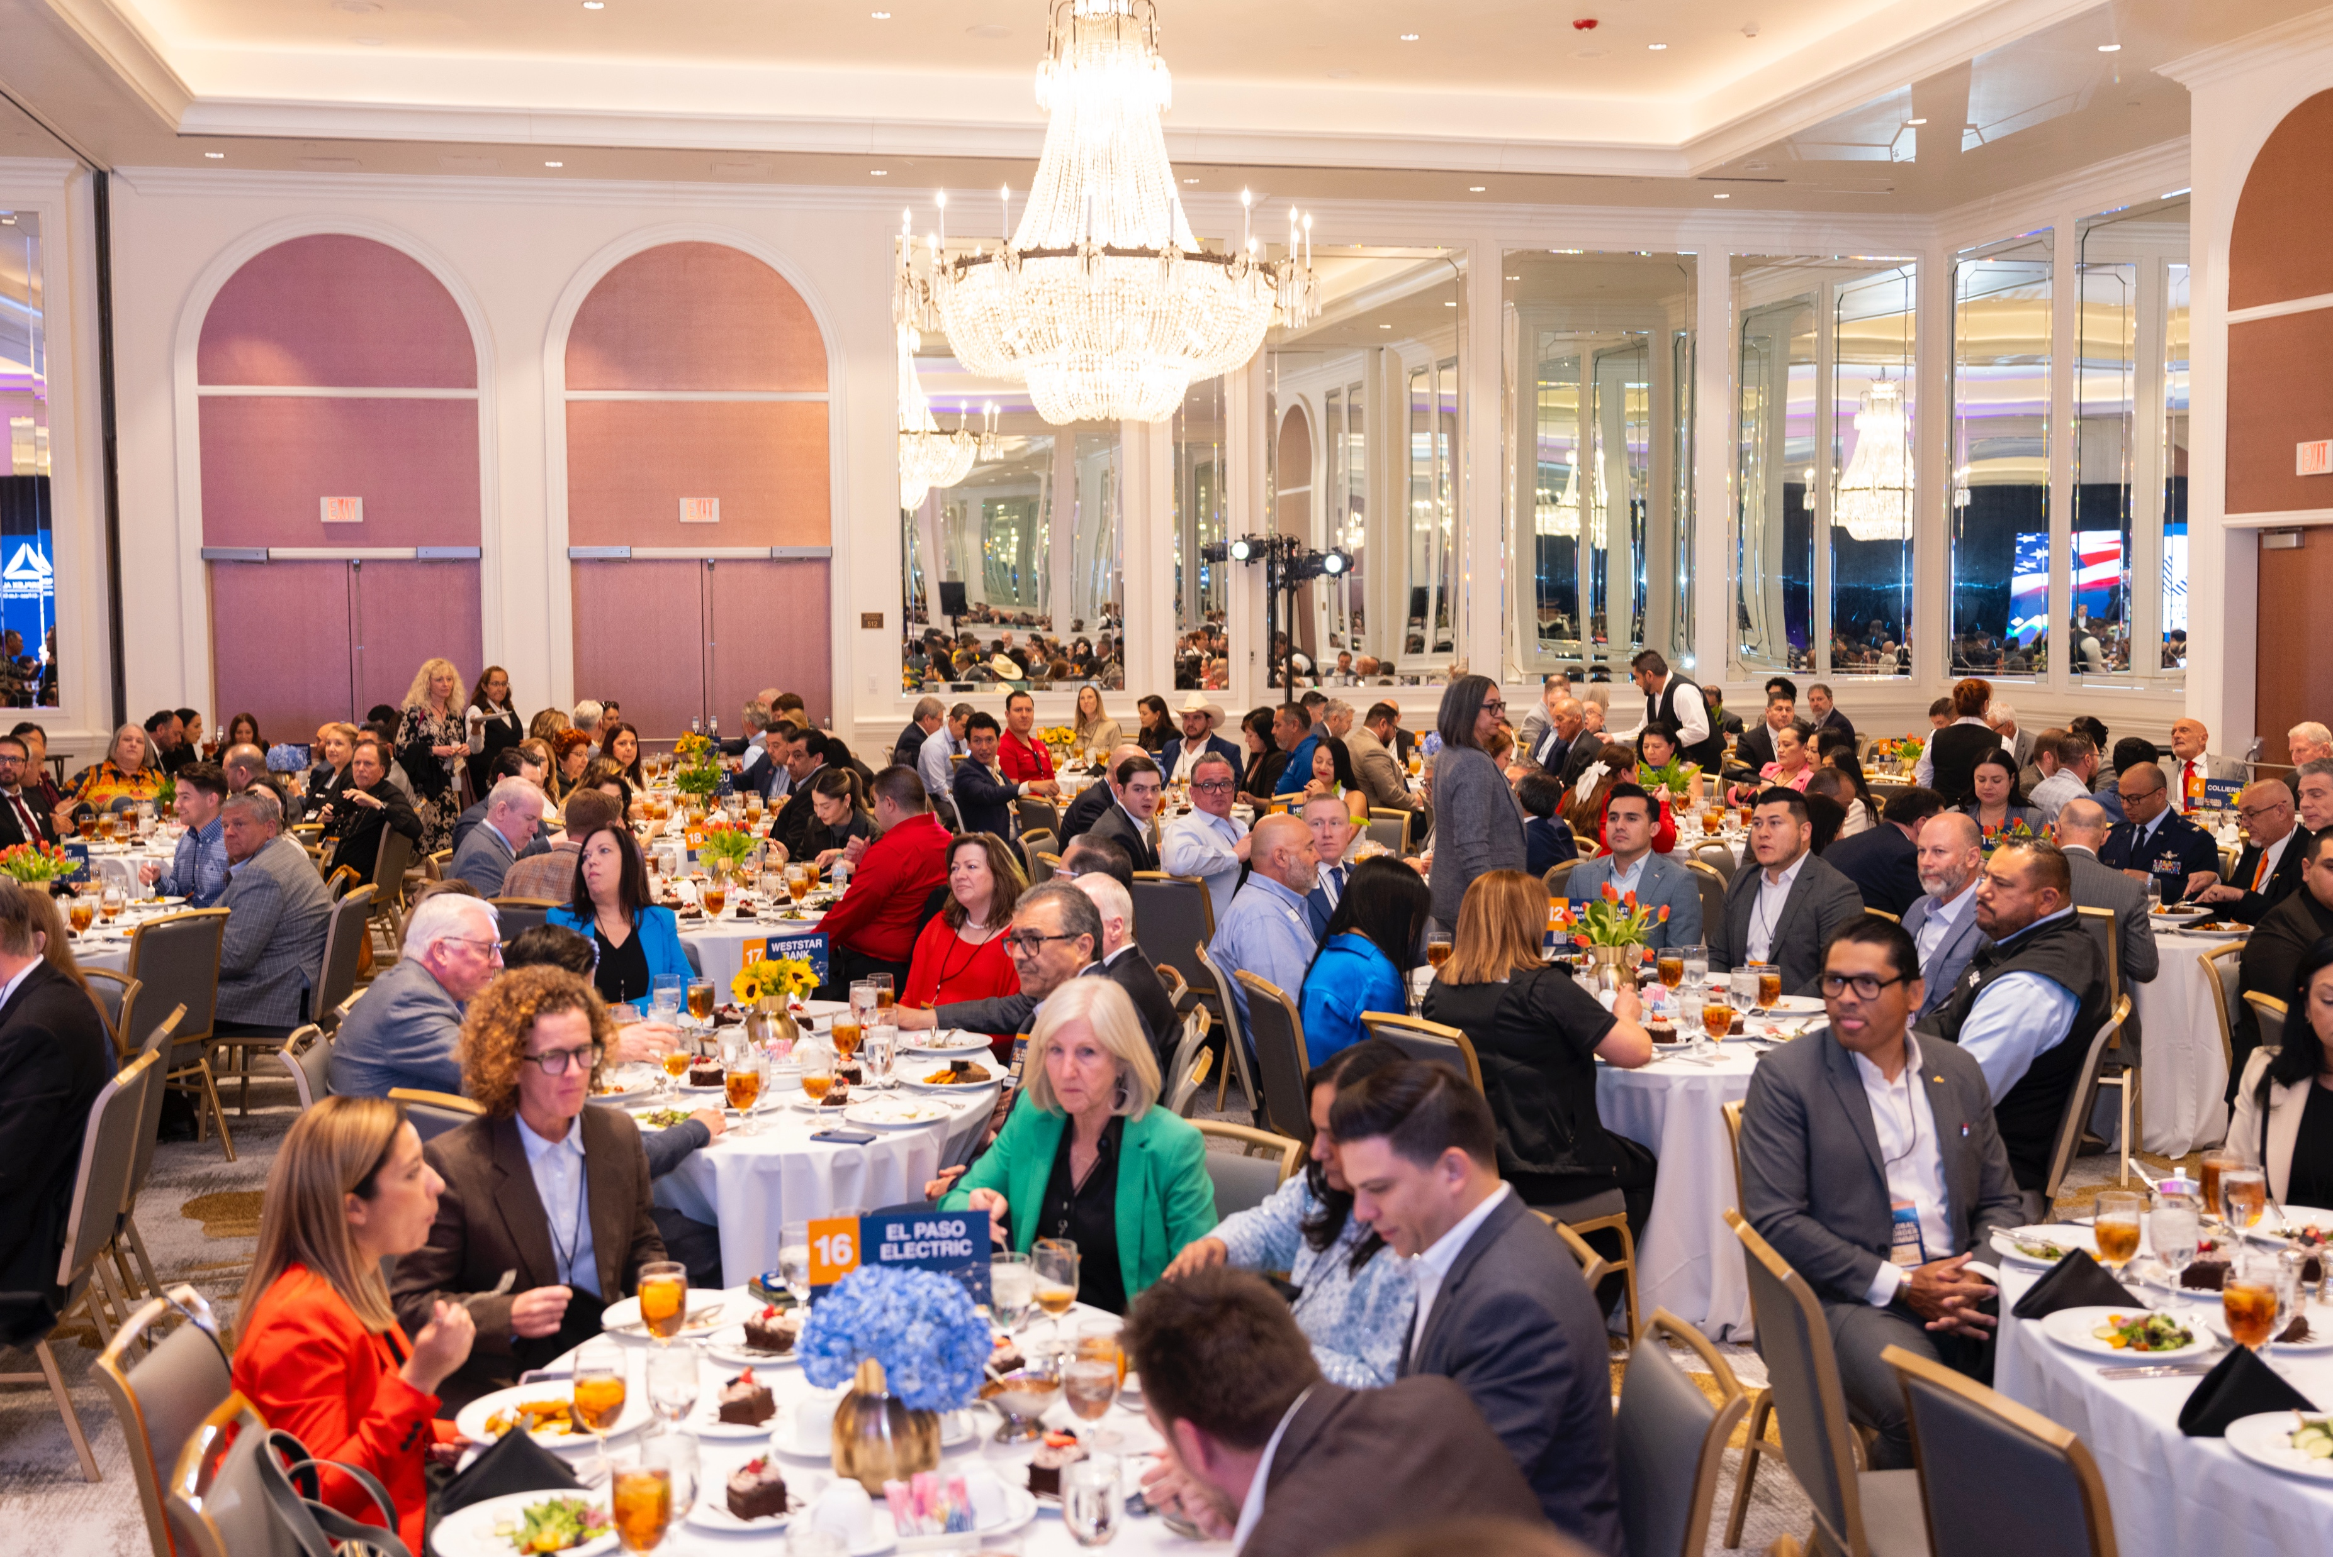
GLOBAL BORDER SUMMIT 2025

Slide 6

AEROSPACE ECOSYSTEM BUILDING
RECENT AND UPCOMING INITIATIVES
Space Innovation Hub: building opportunities for NM-based space companies to compete for R&D defense contracts
Monthly meeting with Spaceport America
Co-Created Marketing Materials for Aerospace & Defense (NMSPA)

Slide 7











2030 BRIDGE PLAN RELEASED JUNE 2025
LAS CRUCES REPRESENTATIVES
Notes:
DACC: Foundational cornerstone piece for the Future od Work report that led to the Binational Tech Council which was the basis for the 2030 BRIDGE Plan.

Slide 8
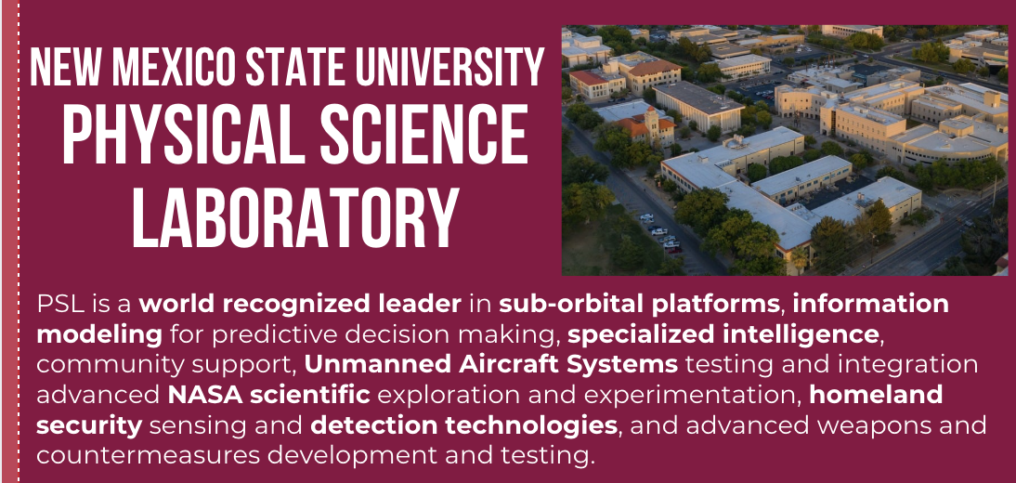
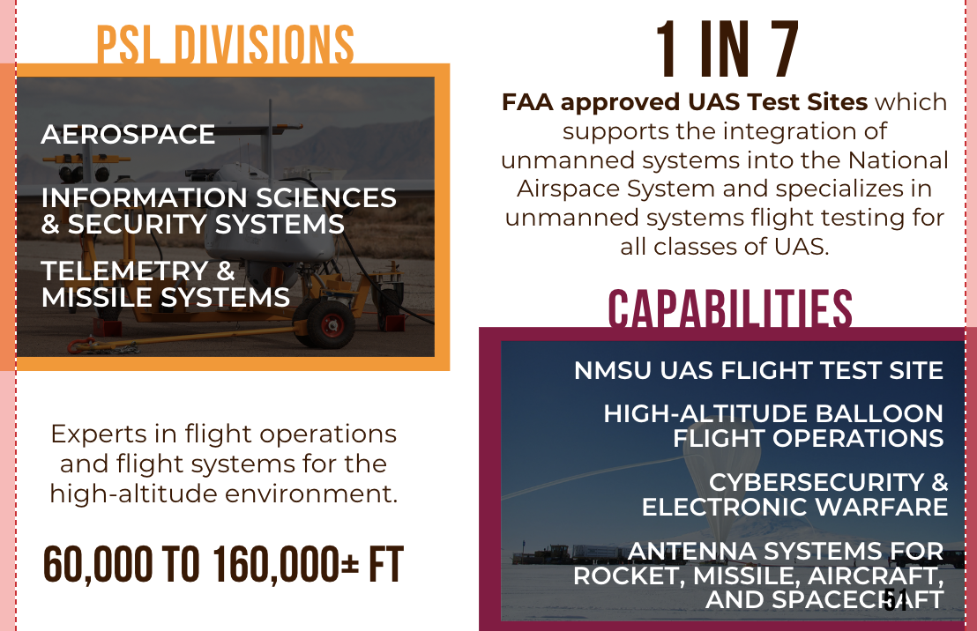
ASSET INVENTORY LISTS FOR STRATEGY & MARKETING
COMPLETED INITIATIVES

Slide 9
Nmsu & ai research project
RECENT AND UPCOMING INITIATIVES
Cooperation with NMSU's Center for Supply Chain Management and Analytics for research project on company adoption of AI in the Borderplex Region
Submitted written history of Binational Technology Council and its role in promoting AI literacy amongst companies and educators
Coordinated meeting with NMSU team and Binational Technology Council to discuss lessons learned about companies' AI adoption sentiment

Slide 10
Borderplex supplier association
RECENT AND UPCOMING INITIATIVES
Buyer-Supplier program: A program that matches local buyers with local suppliers
1 Las Cruces-based Buyer and 10 Las Cruces-based Suppliers signed up on database
All Las Cruces companies, even those not in the Borderplex database, may be contacted for supplier opportunities within the region
5 Supplier Briefs - publications featuring industry-relevant news; features Las Cruces companies and educational institutions

Slide 11
Physician-focused marketing package
RECENT AND UPCOMING INITIATIVES
A marketing package was completed to help attract high demand, low supply specialized physicians
Las Cruces-based entities who participated: 1 large healthcare institution (confidential). Total business participants:
Worked with leadership at regional healthcare institutions to identify the reasons why specialized physicians choose to move, or not to move, to the region
Final marketing product included a report with an analysis of survey results and a marketing PowerPoint and shareable one-pager
Notes:
Dennis Knox and John Hummer

Slide 12
Semiconductor niche analysis project
RECENT AND UPCOMING INITIATIVES
Conducted in-depth asset analysis to uncover top 3 semiconductor niche opportunities
Industry expert-analysts from Arizona State University, Texas A&M, Austin Community College
Identified key assets in southern New Mexico and promoted them as part of the regional ecosystem to help determine niche opportunities within the semiconductor industry
The final report identified the industry specializations with the greatest potential for success and will be used to guide promotion efforts.
3 Top Specializations Identified:
Packaging Manufacturing, 2) Electronics Circuit Design and Integration, and 3) Advanced Sensor Technology

Slide 13
Supplier database & map
RECENT AND UPCOMING INITIATIVES
Created searchable database with visual representation of region's electronics industrial base (supports consumer electronics, energy, semiconductor, automotive, and data center industries)
Generated a report with supply chain analysis
8 suppliers from southern New Mexico found for the electronics supply chain. Two NM suppliers interviewed for added context for the project
Visual database will be used for marketing and business attraction, building a stronger supplier database, and for future workforce initiatives

Slide 14
Thank you!

